Slide 1
ERGAssist User Guide
Please Cite Feola et al. “Development of An Automated Electroretinography Analysis Approach” when using ERGAssist

Slide 2
Index
User Guide
Installation….……………………………………………………
GUI Overview.….………………………………………………
Use.….………………………………………………………………
Outputs ……………………………………………………………
.

Slide 3
Installation
Download and Install Matlab MyAppInstaller_mcr Package from web (Check Readme file)
Download ERGAssist App
Run ERGAssist

Slide 4
GUI Overview

Slide 5
General Information
Time – units ms
Voltage – microvolts (except Celeris where voltage is nanovolts [nV])
Flash Stimuli – log cd*s/m² (except RetEval)
Users can load multiple files that have the same format and steps at the same time
For Toggle Buttons: Orange highlighted = ON

Slide 6
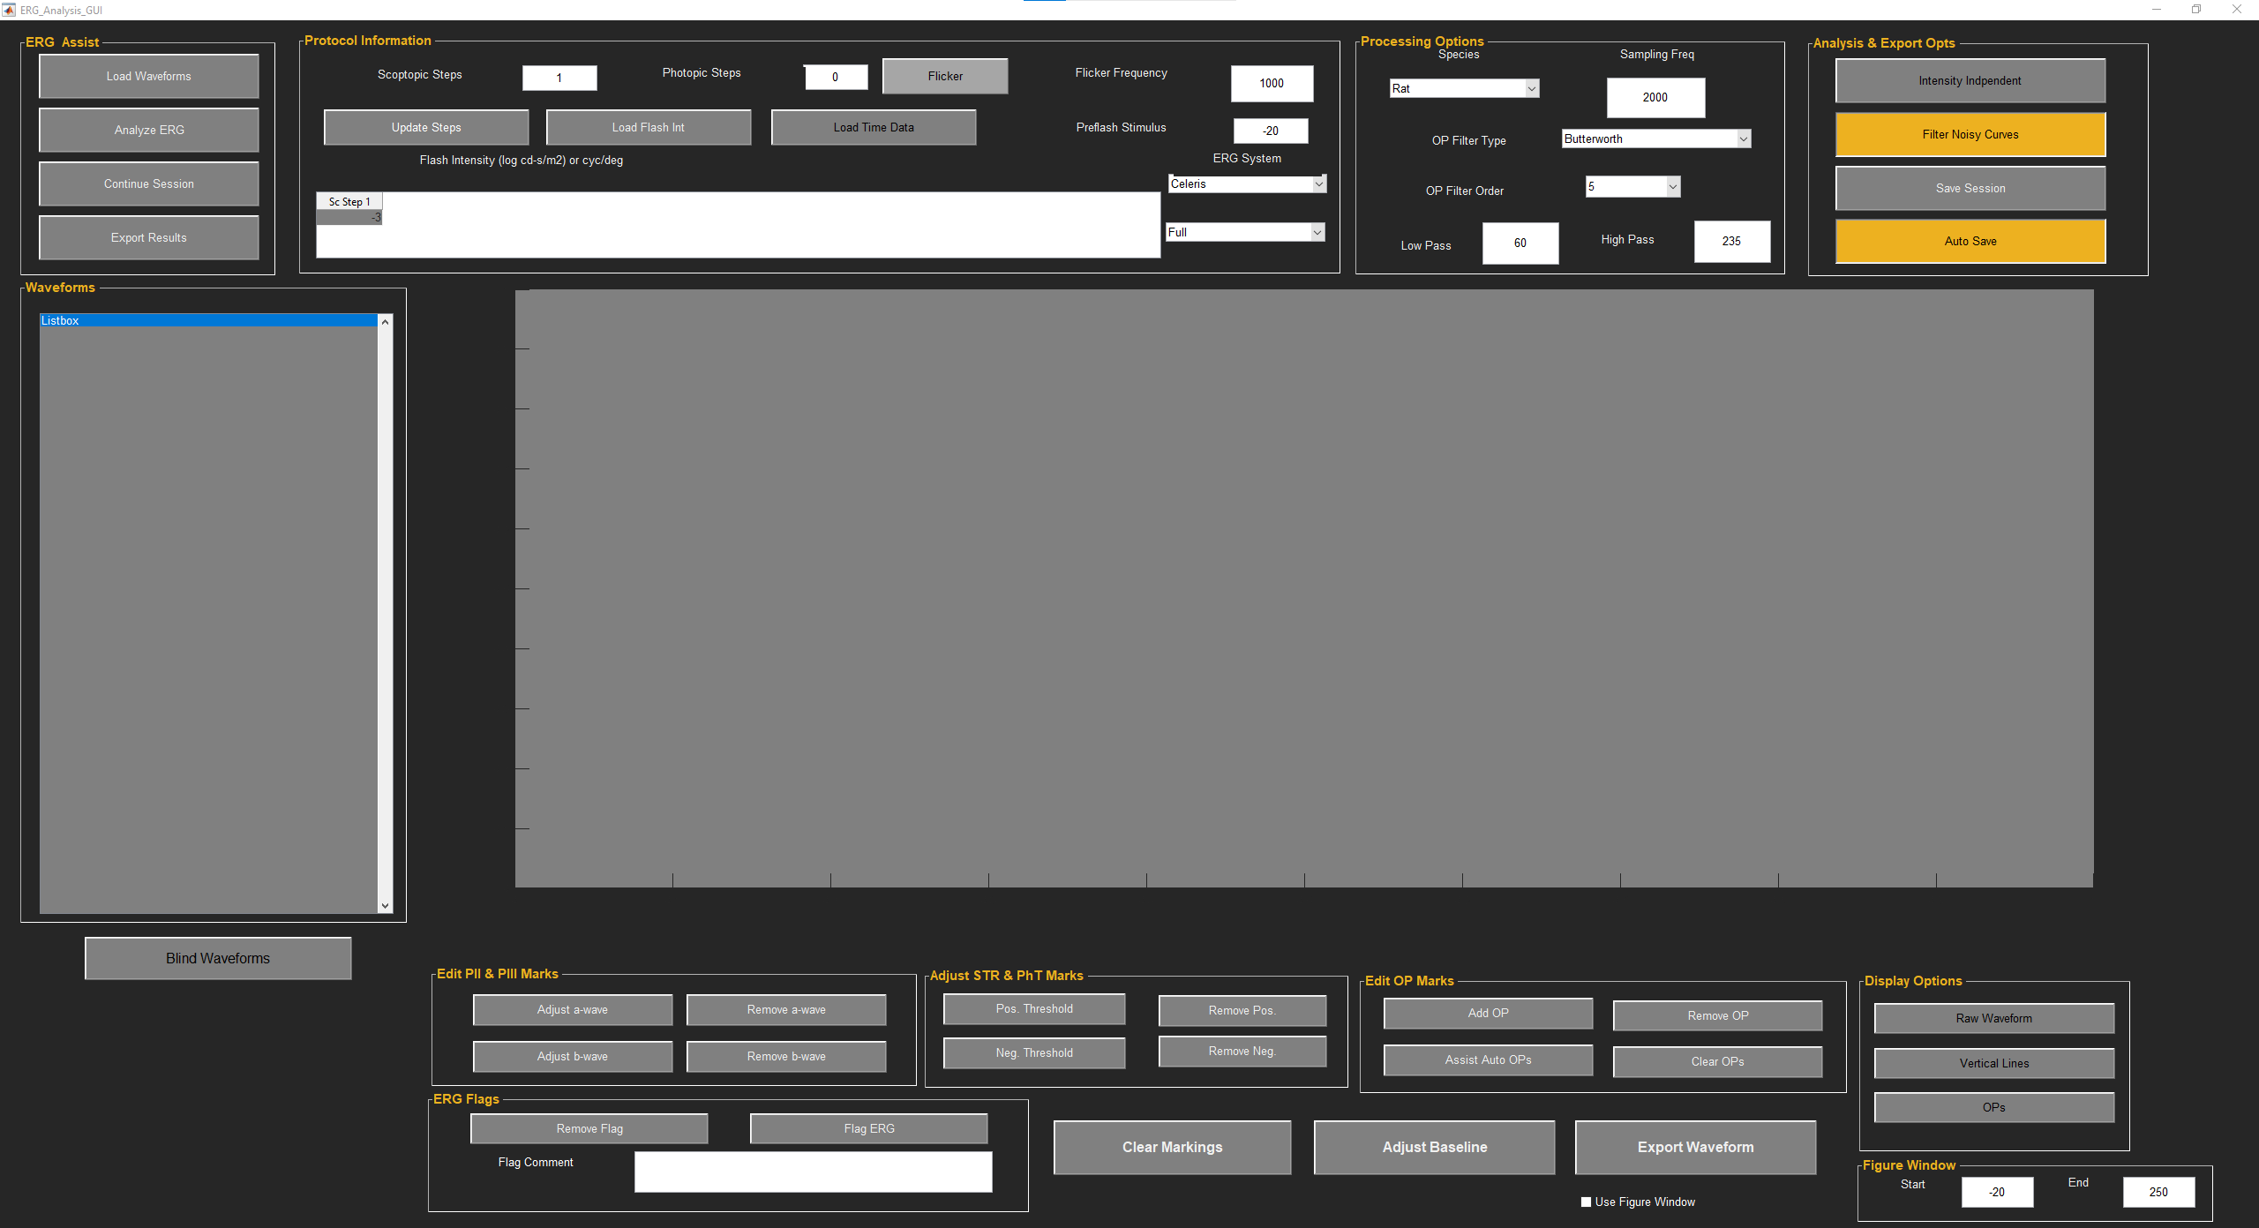
ERGAssist Layout

Slide 7
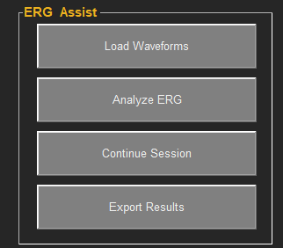
ERG Assist
Load Waveforms
Allows users to upload waveforms
Analyze ERG
Analyzes ERGs
Continue Session
Allows users to load an exported session (from ‘Save Session’) or Automatically exported on export
File type is ‘.mat’
Export Results
Exports marked ERG data into Excel
Also Exports session if ‘Auto Save’ is highlighted

Slide 8
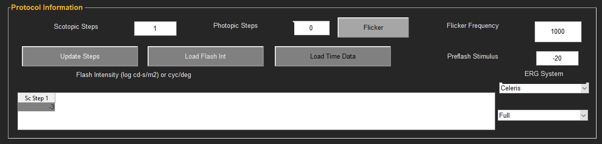
Protocol Information
Scotopic Steps
Allows users to input number of dark-adapted steps (called scotopic here)
Photopic Steos
Allows users to input number of light-adapted steps (called photopic here)
Flicker
Toggle ON / OFF if there was a Flicker step
Update Steps
Updates Table to reflect steps
Load Flash Int
Allows user to upload flash information (Examples 2 and 3)
Load Time Data
Toggle ON/OFF if Excel data includes time information
Flicker Frequency
Allows user to input flicker sampling frequency (only used if Time data is not included)
Preflash Stimulus
Time prior to the flash stimuli (only used if time data is not included)
ERG System
Toggle between how the data was collected/exported

Slide 9
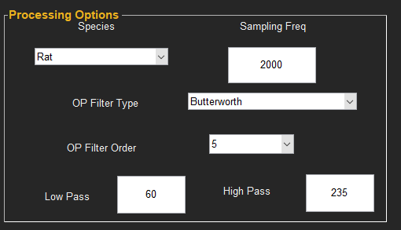
Processing Options
Species
Allows users to adjust between rat/mouse/human inputs
Sampling Freq
Allows users to input sampling frequency to generate time data (only used if Time data is not included)
OPFilter Type
Allows user to toggle between Butterworth and FIR Digital Filter
OP Filter Order
Allows user to adjust the order of the Butterworth filter
Low Pass
Allows user to adjust the low pass filter frequency (Hz)
Used in low-pass and bandpass filter (OP)
High Pass
Allows user to adjust the high pass filter frequency (Hz)
Used in bandpass filter (OP)
Note: Data will need to be reanalyzed to see changes in filters

Slide 10
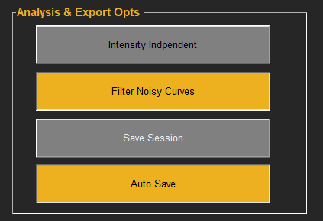
Processing Options
Intensity Independent
Allows users to adjust to ignoring flash stimuli information upon a reanalysis if desired
Filter Noisy Curves
Toggles ON / OFF automatically looking for noisy curves based on frequencies in the signals
Save Session
Allows user to pause analysis and save data as a ‘.mat’ file.
This can be loaded to complete analysis or inspection later
Auto Save
When pressed, upon export a session (‘.mat’ file) will automatically be saved as well with the filename on exported with the addition tag '_Autosave'

Slide 11
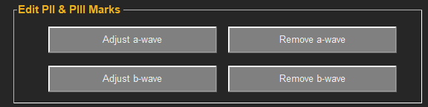
Edit PII & PIII Marks
Adjust a-wave
Moves or adds a-wave mark (red square)
Remove a-wave
Removes a-wave mark
Adjust b-wave
Moves or adds a-wave mark (red circle)
Remove b-wave
Removes b-wave mark

Slide 12
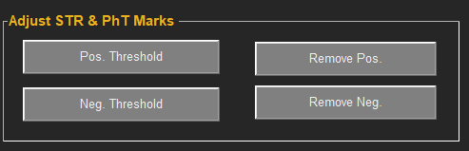
Adjust STR & PhT Marks
Pos. Threshold
Moves or adds positive STR or c-wave peak (blue diamond)
Remove Pos.
Removes positive STR or c-wave peak (blue diamond)
Neg. Threshold
Moves or adds negative STR or negative photopic threshold (blue diamond)
Remove Neg.
Removes negativeSTR or c-wave peak (blue diamond)

Slide 13
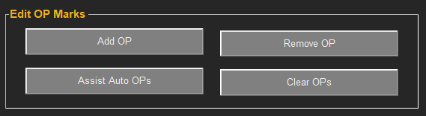
Edit OP Marks
Add OP
Add OP (start with trough then peak)
Remove OP
Removes selected OP (select trough then peak)
Assist Auto OPs
Clears OPs and allows user to select trough of first OP. Others are automatically selected from this point
Clear OPs
Removes all OPs
Note: ERGAssist currently only allows 5 OPs to be marked

Slide 14
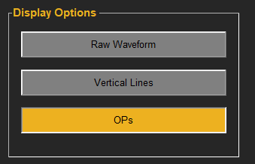
Display Options
Raw Waveform
Displays the raw ERG data (black line) underneath the processed waveform
Vertical Lines
Displays dashed vertical lines at the location of the a-wave and b-wave
OPs
Toggles ON/OFF oscillatory potential waveform from bandpass filter

Slide 15
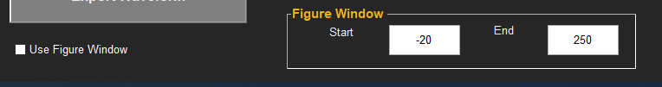
Figure Window
Allows adjustment of time displayed
Start
Beginning of x-axis display
End
End of x-axis display
Use Figure Window
Toggles ON / OFF using Figure Window range on the plots

Slide 16
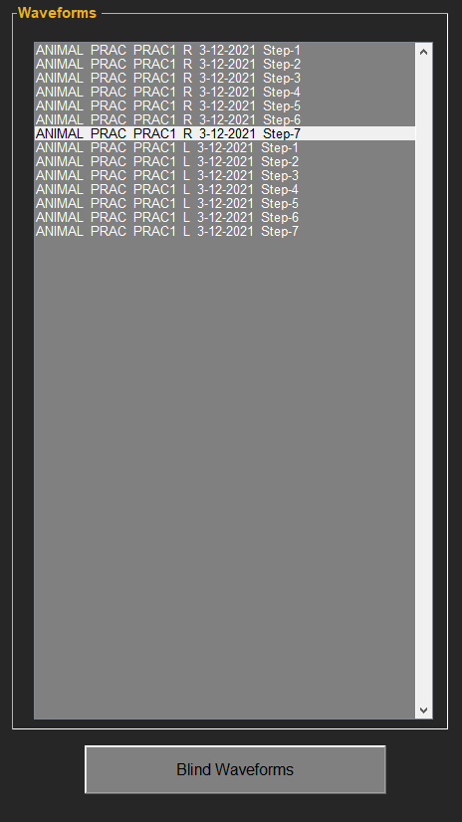
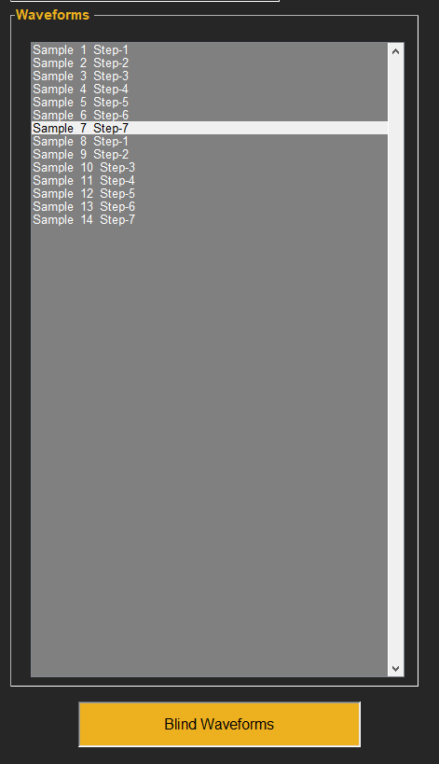
Blind Waveforms
Toggles ON /OFF blinding of ID information for blinded analysis

Slide 17
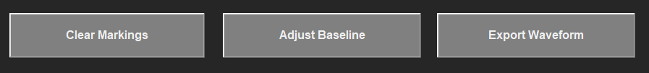
Misc. Items
Clear Markings
Clears all markings from current waveform
Adjust Baseline
To adjust the reference point (baseline) that is considered 0 Volts
Export Waveform
Exports current waveform data (voltage, time, and OP data)

Slide 18
Example 1 Loading From Excel
Manually Input Flash and Time Information

Slide 19
Key Information For Example 1
User Needs to Update:
Flash Type: Dark Adapted (Scotopic), Light Adapted (Photopic), Flicker
User also inputs flash stimuli information
Sampling Frequency
Flicker Frequency (if applicable)
Pre-stimulus time
Generates time data from User Input
Time waveform is generated from sampling frequency (Hz)
No time data is included in the Excel file (only voltage response)
Voltage data is in microvolts

Slide 20

Shows:
Loading step type and manually inputting flash stimuli (flash intensities)
Illustrating toggling on/off OP waveforms

Slide 21
Example 2 Loading From Excel
Load Input Flash Stimuli and Time Information

Slide 22
Key Information For Example 2
User Needs to Update:
Flash Steps: Dark Adapted (Scotopic), Light Adapted (Photopic), Flicker
Load file containing flash stimuli information
Can be a single row or column
File format: txt, xlsx, xls, or csv
Loads Time Data from User Input
Flash log cd-s/m²
Excel file contains time (ms) and voltage (microV) information

Slide 23
Shows:
Loading flash stimuli (flash intensities) after determining step type
Illustrating automatically flagged waveforms and removing a flag

Slide 24
Example 3 Loading From Excel
Load Input Flash and Flash Type and Time Information

Slide 25
Key Information For Example 3
User Needs to Update:
Flash Steps: Dark Adapted (Scotopic), Light Adapted (Photopic), Flicker
Load file containing flash stimuli information
Should be two rows
File format: txt, xlsx, xls, or csv
Step Key
0 – Dark Adapted (scotopic); 1 – Light Adapted (photopic); 2 – Flicker
Loads Data from User Input
Excel file containing voltage (microV) information

Slide 26
Shows:
Loading flash stimuli (flash intensities) and type of flash
Changing species from rat to mouse
Noisy curve filtering
Results in flagged waveforms (black highlight)
Renanalzying data without filtering out noisy curve
Results in flagged waveforms (blue highlights)
Should be checked
Shows Adjusting placement of b-wave amplitude

Slide 27
Example 4 Loading From LKC Device

Slide 28
Key Information For Example 4
User Needs to Update:
Flash Steps: Dark Adapted (Scotopic), Light Adapted (Photopic), Flicker
Directly load LKC data from Bigshot or SunBurst
Loads Data from User Input
Directly load LKC data from
Time should be in ms and Voltage should be in microV
Note: This Example shows using ‘Estimate Step Type’ Import (beta Version)

Slide 29
Shows:
When you do not adjust flash stimuli
Highlights feature to have the program estimate the type of waveform (dark-adapted, light-adapted, or flicker)
Note: This is a beta version and classifications were trained on rat data collected on an LKC device.
Shows using ‘Assist Auto OPs’
Clears all OPs and allows the user to manually mark the first trough (the program will then automatically mark OP1-5 based on this placement

Slide 30
Example 5 Loading From Celeris

Slide 31
Key Information For Example 4
User Needs to Update:
Flash Steps: Dark Adapted (Scotopic), Light Adapted (Photopic), Flicker
Directly load Celeris file
Loads Data from User Input
Directly load LKC data from
Time should be in ms and Voltage should be in nanoV
Note: This Example shows using ‘Continue Without Flash Intensity’ Import

Slide 32
Shows:
When you do not adjust flash stimuli
Highlights feature to have the program ignore conditions and analyze independently.
Note: A flicker waveform will be analyzed the same including looking for a-wave, b-wave and OPs. These will need to be reanalyzed manually.
For Celeris data (if you have all dark-adapted steps) you can import the flash information directly
Shows using ‘Clear OPs’
Clears all OPs
Shows ‘Adjust a-wave’ and ‘Adjust b-wave’ butons
This allows you to manually adjust markings

Slide 33
Output Format

Slide 34

Excel Output
ERG
Test Date
Subject ID
Output Parameter
DATA
DATA
DATA
Eye
Step
Number
Flag (and note)

Slide 35
Output Parameters:
A Amp – a-wave amplitude
A IT – a-wave implicit time
B Amp – b-wave amplitude
B IT – b-wave implicit time
OP1 IT – oscillatory potential 1 implicit time
OP1 Amp – oscillatory potential 1 amplitude
OP information is repeated for OP 1 -5
pSTR Amp – positive scotopic threshold (STR) amplitude (also c-wave)
pSTR IT – positive STR implicit time (also c-wave)
nSTR Amp – negative STR amplitude (also negative photopic threshold response)
nSTR IT – negative STR implicit time (also negative photopic threshold response)
Note: all exported amplitudes are in microV (including Celeris) and implicit times are in ms

Slide 36
ERG Waveform File Formats
Generic
Excel
LKC
Bigshot
Sunburst
RetEval
Diagnosys
Celeris

Slide 37
General Data Organization
Note: This does not apply if you are Ignoring Flash Information or Estimating Step Type (akin to Examples 4 and 5)
Dark Adapted Steps are First
Dark Adapted Steps are Referred to as Scotopic (Sc)
Light Adapted Steps are Referred to as Photopic (Ph)
Flicker
Flicker is the last step
Only a single Flicker Step per eye

Slide 38
CHECK DATA
ERGAssist helps in quickly analyzing ERG data, but it is STRONGLY encouraged that all waveforms are quickly examine each waveform to ensure markers are accurate and align with your laboratories practices in marking waveforms
If there is a bug or desired change. Please communicate with the Corresponding Author of “Development of An Automated Electroretinography Analysis Approach” Andrew Feola, Ph.D. @ andrew.feola@emory.edu

